Slide 1

Continuous Integration and Continuous Deployment Options

Slide 2
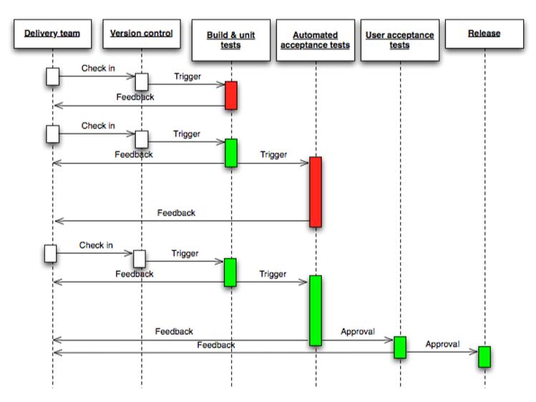
Typical Workflow

Slide 3
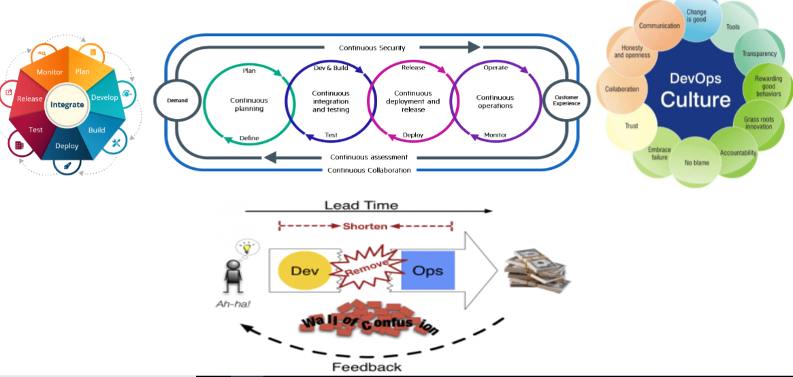
DevOps Way

Slide 4
DevOps Benefits
Fast-track the release of applications into production
Tolerate continuous feedback and improvement across the software lifecycle
Reduce time to market through streamlined testing and CD
Improve efficiency and utilization of resources
Adoptive an environment of:
1.Collaborative Development
2.Continuous Testing
3.Continuous Release and Deployment
4.Continuous monitoring

Slide 5
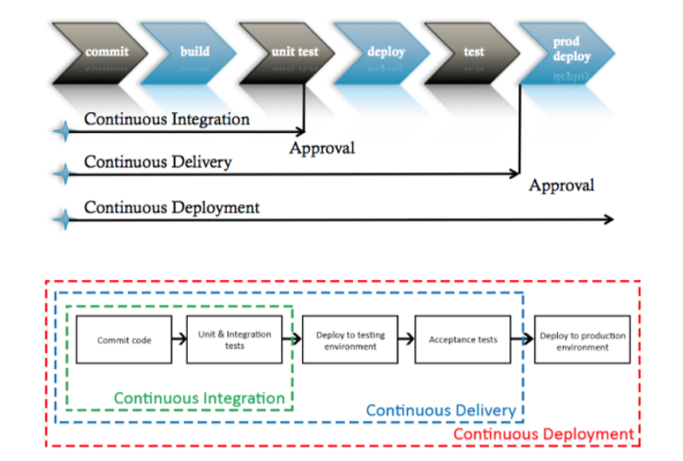
Continuous Pipelines

Slide 6
CI/CD Implementation Options
DevOps Tools
Azure DevOps
Tools Should be hosted on on- premise servers.
Individual tools for each section of DevOps Process
Artifactory repository will be hosted on either Nexus/Jfrog .
Microsoft - Azure DevOps Comes Up with SaaS for the users.
All Sections of DevOps process comes with as Out of box features.
Azure Artifacts available as out of box feature. Otherwise can use Nexus/Jfrog as artifactory repository.

Slide 7
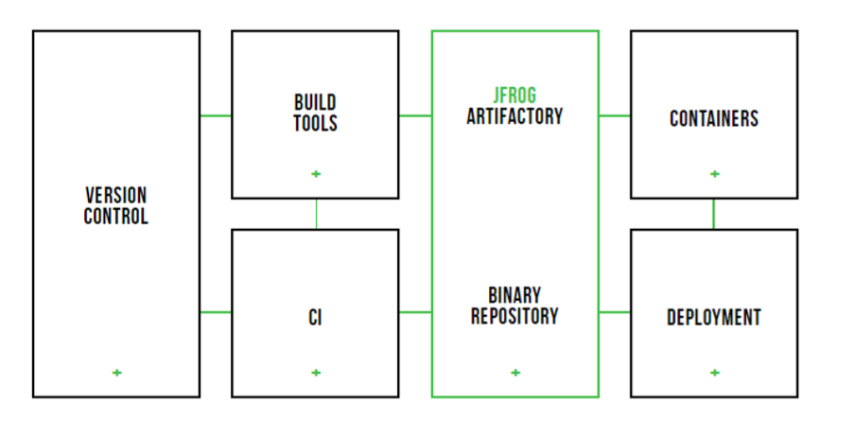
Tools Integration Plan

Slide 8
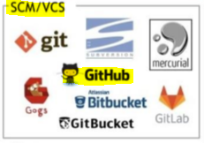
Source Code Management Tools:
We already have GitHub as our organizational central repository.

Slide 9
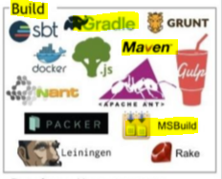
Build Tools:
We have to choose the build tools based on the code base pushed to the repository.
We can choose Maven/Gradle for java code base and MSBuild for DotNet code base.
Maven/Gradle , MSBuild are open source and Freeware.
These can be installed on Jenkins build server.
Input from GitHub
(Source Code)
Output
(Artifacts
.war/dll etc.)

Slide 10
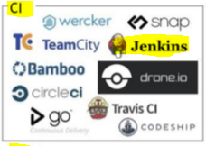
CI Tools:
Job of CI Tools is to automate the CI/CD jobs
Integrates GitHub and Build tools (CI Jobs)
Integrates Artifactory repository(Nexus/Jfrog)
Deploy the artifacts on web servers (CD Jobs)

Slide 11
Jenkins is the market leader among the CI tools available.
Jenkins follow master-slave architecture.
Jenkins will be installed first on single server(master) and can scale up as slaves ,build servers and release servers.
Jenkins is open source and freeware.
Jenkins masters will require regular plugin updates, semi-monthly core upgrades, and regular backups of configurations and build histories.

Slide 12
Artifactory Repository:
An Artifact repository is both a source for artifacts needed for a build, and a target to deploy artifacts generated in the build process.
Artifactory provides tight integration with popular CI systems available today such as Jenkins.
Systems use Artifactory to supply artifacts and resolve dependencies when creating a build, and also as a target to deploy build output.
Artifactory provides plugins for the build tools you use (such as Maven and Gradle) which ultimately provides the same level of build automation.
Main competitors in market are JFrog Artifactory and Sonatype Nexus

Slide 13
Artifactory Vs. Nexus The Integration Matrix
 | JFrog Artifactory | Nexus
Support on-Prem
Support Cloud
Support multi-Cloud
Support hybrid Architecture
Support nearly every UI feature in REST
Exhaustive Build info and highly flexible query for search based on metadata

Slide 14
 | JFrog Artifactory | Nexus
Supports all major cloud storage providers(AWS , GCS , Azure blob storage)
Filestore sharding
Pull replication through remote proxy
Active push replication to single target
Event based pull replication
Active simultaneous push replication to multiple targets
Supports any repository layout. Able to natively accommodate any package format.

Slide 15
Sonatype Nexus(Repository manager) Features:
Manage components, build artifacts, and release candidates in one central location
Understand component security, license, and quality issues
Scale DevOps delivery with high availability and active/active clustering
Modernize software development with intelligent staging and release functionality
Universal support for all your favorite formats and tools.
Store and distribute Maven/Java, npm, NuGet, RubyGems, Docker, P2, OBR, APT and YUM and more.
Integrated with popular tools like Eclipse, IntelliJ, Hudson, Jenkins, Puppet, Chef, Docker, and more
Installed on on premise server.

Slide 16
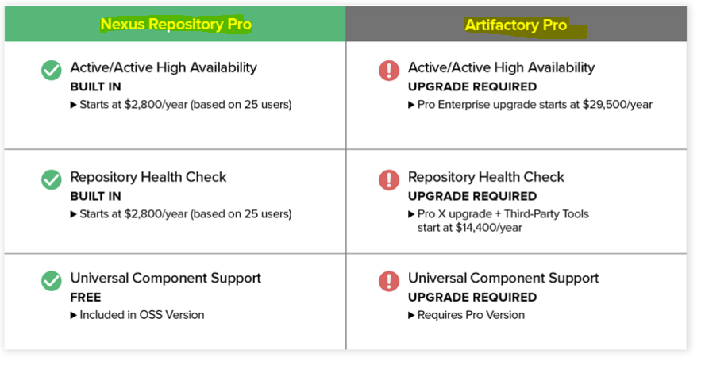
Sonatype Nexus Pricing:
Comes with free(OSS) and Pro Versions. Free version supports almost all features as than JFrog Free version
Nexus Repository pro Vs JFrog Artifactory pro pricing

Slide 17
JFrog Artifactory Features:
Artifactory Query Language- A simple way to formulate complex queries that can find artifacts based on any number of search criteria.
Black Duck Code Center integration - Automate security and license governance of open source components and software.
License Control - Manage and control your organization's licensing policies for third-party dependencies used by your software
Repository Layouts - Define the layout by which software modules are identified in your repository for automatic cleanup of old versions and cross-repository layout conversion.
JFrog CLI - A simple interface that automates access to Artifactory through a compact and smart client.
Repository Replication - Actively synchronize your repository content and metadata with remote Artifactory repositories using pull or push replication.

Slide 18
REST API - Automate your repository management and release life-cycle with a powerful REST API
High Availability - Deploy Artifactory in a high availability configuration to maximize uptime (up to five-nines availability), manage heavy loads and minimize maintenance downtime.
Watches - Watch selected artifacts, folders, or repositories for any event , and receive email notifications on changes that are interesting to you.
Multi-push Replication - Replicate a repository to multiple remote sites simultaneously.
Webstart and JAR Signing - Manage signing keys and sign JAR files for use with Java Web Start.
Support for all your favorite formats and tools.

Slide 19
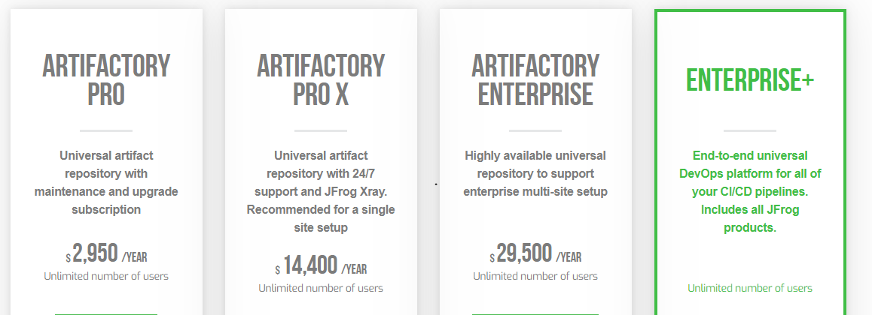
JFrog Pricing:
Comes with on-premise and cloud options.
Free Version(Artifactory OSS) have very limited options compared with Nexus.

Slide 20
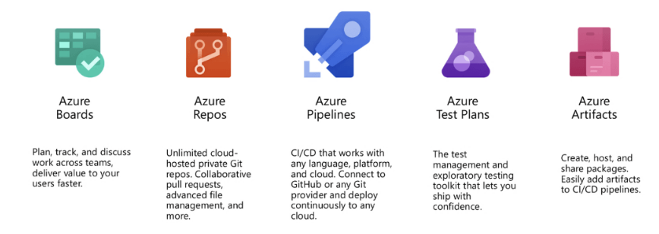
Azure DevOps:
Azure DevOps provides unlimited private Git hosting, cloud build for continuous integration, agile planning, and release management for continuous delivery to the cloud and on-premises. Includes broad IDE support
With Azure DevOps you get Azure Boards, Azure Repos, Azure Pipelines, Azure Test Plans, and Azure Artifacts

Slide 21
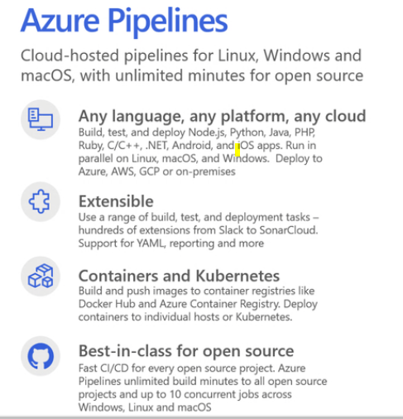
Azure Pipelines:
With Azure Pipelines, you get cloud-hosted pipelines for Linux, Windows, and macOS. You can build, test and deploy any language or platform to any cloud.

Slide 22
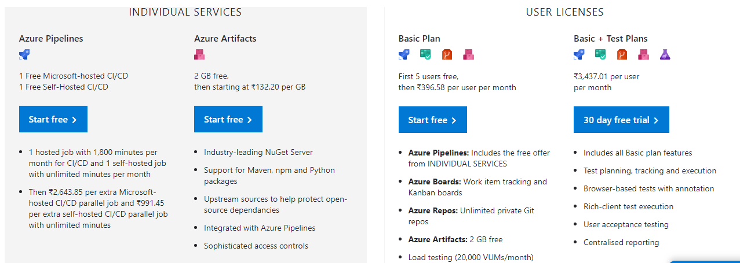
Azure DevOps Pricing:
Comes with Azure DevOps services(Saas) and Azure DevOps server(on- premise)
Azure DevOps services pricing

Slide 23
Azure DevOps server Pricing:
DevOps Server is a set of collaborative software development tools, hosted on-premises.
With Azure DevOps Server 2019 you can either pay month-to-month through Azure or you can buy classic software licenses which requires a 3-year commitment.
Buying through Azure provides bonus of entitling you to use our cloud service, so you can move to the cloud at your own pace.
With either option, you will also need Windows or Windows Server licenses for the servers running Azure DevOps Server 2019.

Slide 24
Thank You

